Slide 1








TESTING
ALBUM ADMIN WEBSITE
created by 3SE4

Slide 2



MEET OUR TEAM
Faza Naziila Dias Shanti
Salvia Maylie Budiawati
2320010208
2320010276
Notes:
Assalamualaikum Good morning, Before starting the presentation, we would like to express our deepest gratitude to Mr. Riza Muhammad Nurman, as our supervisor, who has provided guidance and direction during the process of preparing this material. We would also like to thank Mr. Feri Nugroho as the examiner who was present .We are from group 2. My name is Salvia Maylie Budiawati, and my partner's name is Faza Naziila Dias Shanti. In our presentation, we will show a website admin album.

Slide 3


TESTING ALBUM ADMIN WEBSITE
As the Album Admin Website has done, as a programmer, there is no guarantee that there are no human mistake had made. Hence, to make the website into a perfect one, the testing with Junit testing using Java Netbeans, Blackbox testing for manual test, JaCoCo, and Jmeter for load testing should be done. We tested the methods in the DAO and model.

Slide 4

INDEX.XHTML
Test Planning & Testing Implementation
No. | Test Case | Test Data | Expected Result | Result
1. | user Sign in by clicking Sign In button | User click Sign In button | go to signin.xhtml page | PASS

Slide 5
SIGNIN.XHTML
Test Planning & Testing Implementation
No. | Test Case | Test Data | Expected Result | Result
1 | user input username and password into the Sign In form and click the Sign In button | User fill the valid username and password | the system will go to the admin page and display the username on the top section of the page | PASS
2 | user input username and password into the Sign In form and click the submit button | User fill the wrong username and password | the system will show "Login Failed" | PASS
3 | User click the cancel button in the Sign In page | Use click the cancel button | the system will display the index page | PASS

Slide 6
ADMIN.XHTML
Test Planning & Testing Implementation
No. | Test Case | Test Data | Expected Result | Result
1 | user add a new album by filling the content | User input the content data: album image, album title, description, album links, and unit ID | stay in admin page and the album data will be updated, and the inputed data will be saved in the database | PASS
2 | user add a new album with empty content data | The content left empty | stay in admin page and the album data will be updated, and the data will be stay unchanged | FAILED
3 | user edit the data of an album and click save button | User change the album data | stay in admin page and the album data will be updated, and the edited data will be saved in the database | PASS

Slide 7
ADMIN.XHTML
Test Planning & Testing Implementation
No. | Test Case | Test Data | Expected Result | Result
4 | user delete an album by clicking the delete button | user delete an album | stay in admin page and the album data will be updated, and the chosen data will be deleted in the database | PASS
5 | user add a new news row by filling news data and click the Add News button | User input the content data: news image, news content, Unit ID | stay in admin page and the news data will be updated, and the inputed data will be saved in the database. The inputed data will be showed in the News page | PASS
6 | user add a new news row by left the news data empty and click the Add News button | The content left empty | stay in admin page and the news data will be updated, and the data will be stay unchanged | FAILED

Slide 8
ADMIN.XHTML
Test Planning & Testing Implementation
No. | Test Case | Test Data | Expected Result | Result
7 | user edit either the news image or news content and then click the save button | User change a news image/news content | stay in admin page and the news data will be updated, and the edited data will be saved in the database. The data will be updated in the News page | PASS
8 | user delete a news by clicking the delete button | user delete a news | stay in admin page and the news data will be updated, the chosen data will be deleted in the database and in the News page. | PASS
9 | user add a new member by inputing the data and click add new member button | user input the content data: member name, image address, role, and unit | stay in admin page with "Success" message and the data will be updated both in the page and in the database. The data will be shown in the each Unit's page | PASS

Slide 9
ADMIN.XHTML
Test Planning & Testing Implementation
No. | Test Case | Test Data | Expected Result | Result
10 | user add a new member by left the data empty and click add new member button | The content left empty | stay in admin page and the news data will be updated, and the data will be stay unchanged | FAILED
11 | user edit a member's name, image address, role and click the save button | user change a member's name, image address, or role, or all of it | stay in admin page with "Success" message and the data will be updated both in the admin page and in the database. The data also will be updated in the each Unit's page | PASS

Slide 10
ADMIN.XHTML
Test Planning & Testing Implementation
No. | Test Case | Test Data | Expected Result | Result
12 | user delete a member by clicking delete button | user delete a member | stay in admin page with "Success" message and the data will be updated both in the admin page and in the database. The data also will be deleted in the each Unit's page | PASS
13 | user logging out b by clicking Log Out button in the admin.xhtml page | user click Log Out button | go to index.xhtml page | PASS

Slide 11
HEADER.XHTML
Test Planning & Testing Implementation
No. | Test Case | Test Data | Expected Result | Result
1 | go to news.xhtml page by click News text on the navigation bar | click News text on the navigation bar | display news.xhtml page | PASS
2 | go to nct127.xhtml page by click NCT 127 text on the navigation bar | click NCT 127 text on the navigation bar | display nct127.xhtml page | PASS
3 | go to nctDream.xhtml page by click NCT Dream text on the navigation bar | click NCT Dream text on the navigation bar | display nctDream.xhtml page | PASS

Slide 12
HEADER.XHTML
Test Planning & Testing Implementation
No. | Test Case | Test Data | Expected Result | Result
4 | go to nctU.xhtml page by click NCT U text on the navigation bar | click NCT U text on the navigation bar | display nctU.xhtml page | PASS
5 | go to wayV.xhtml page by click WayV text on the navigation bar | click WayV text on the navigation bar | display wayV.xhtml page | PASS
6 | go to admin.xhtml page by click Admin text on the navigation bar | click Admin text on the navigation bar | display admin.xhtml page | PASS

Slide 13
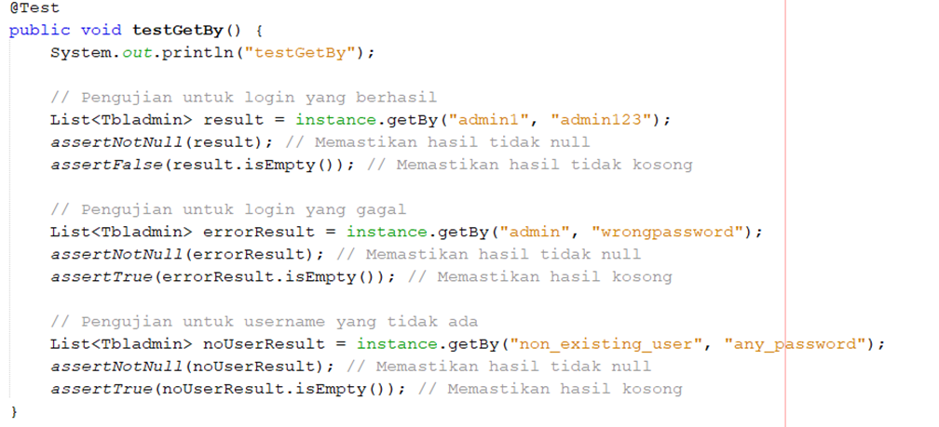
TESTING IMPLEMENTATION
AdminDAOTest.java

Slide 14
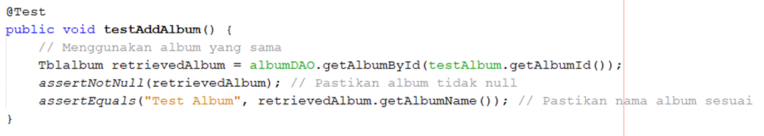
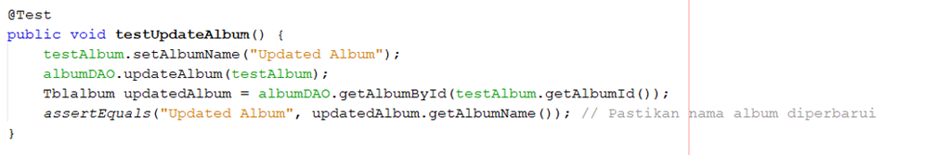
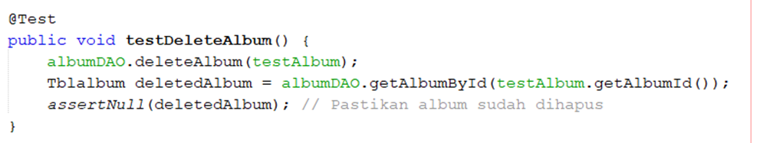
TESTING IMPLEMENTATION
AlbumDAOTest.java

Slide 15
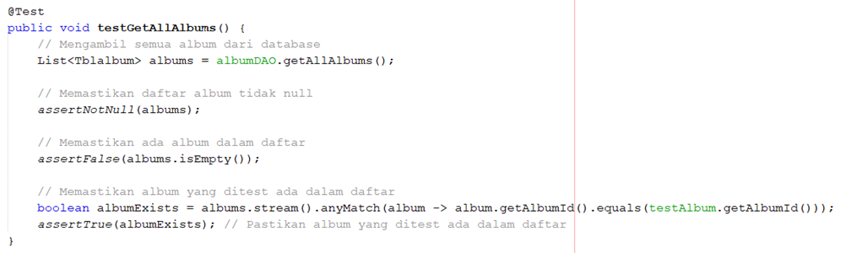
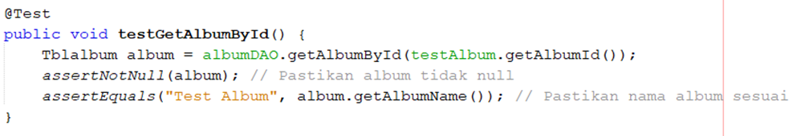
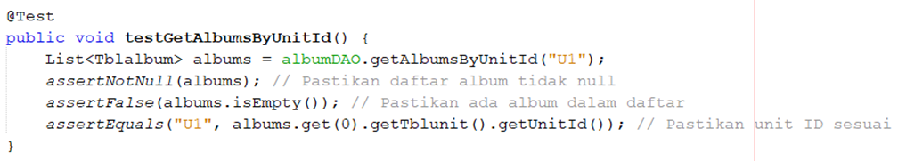
TESTING IMPLEMENTATION
AlbumDAOTest.java

Slide 16
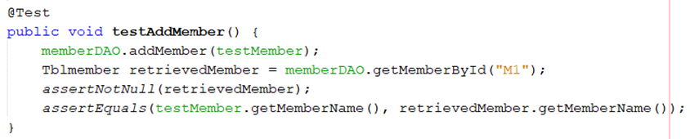
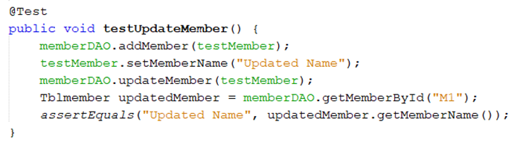
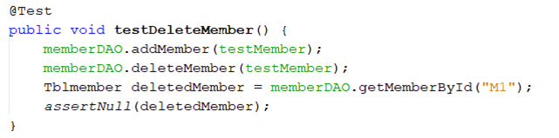
TESTING IMPLEMENTATION
MemberDAOTest.java

Slide 17
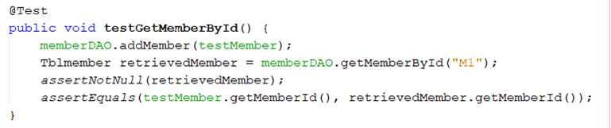
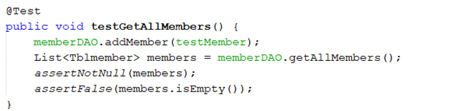
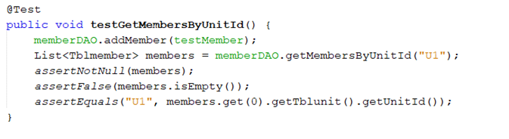
TESTING IMPLEMENTATION
MemberDAOTest.java

Slide 18
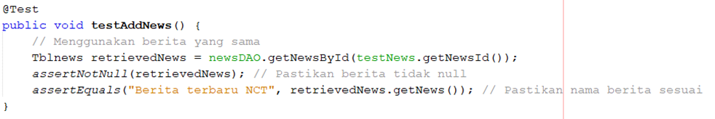
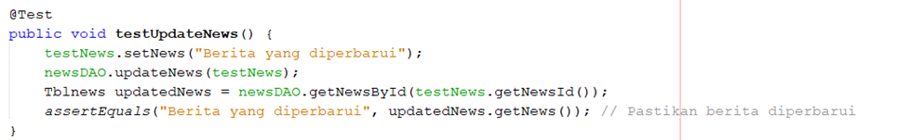
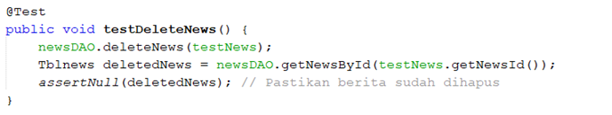
TESTING IMPLEMENTATION
NewsDAOTest.java

Slide 19
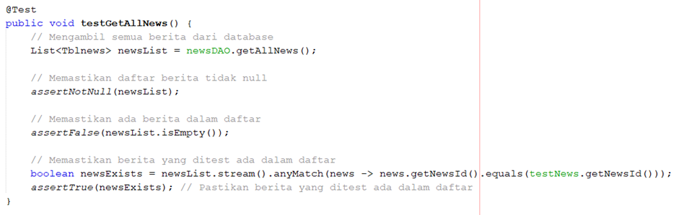
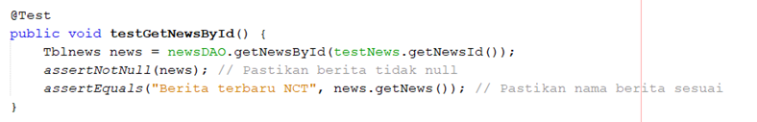
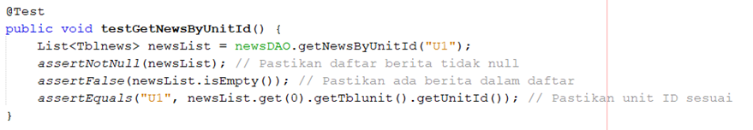
TESTING IMPLEMENTATION
NewsDAOTest.java

Slide 20
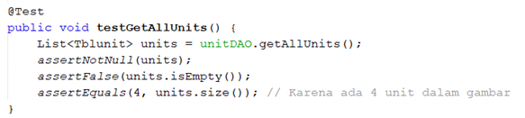
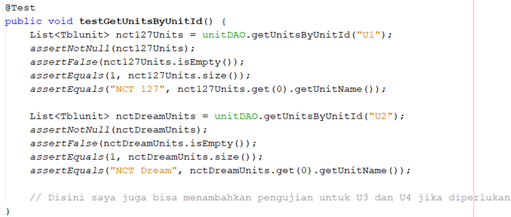
TESTING IMPLEMENTATION
UnitDAOTest.java

Slide 21
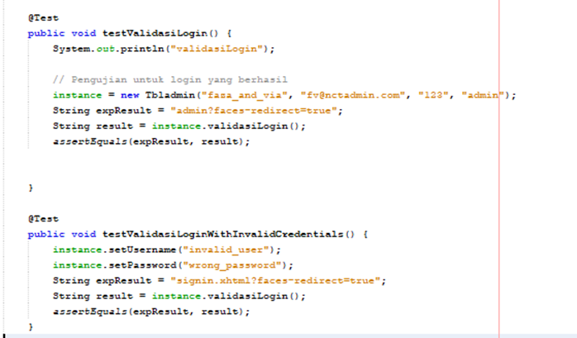
TESTING IMPLEMENTATION
TblAdminTest.java

Slide 22
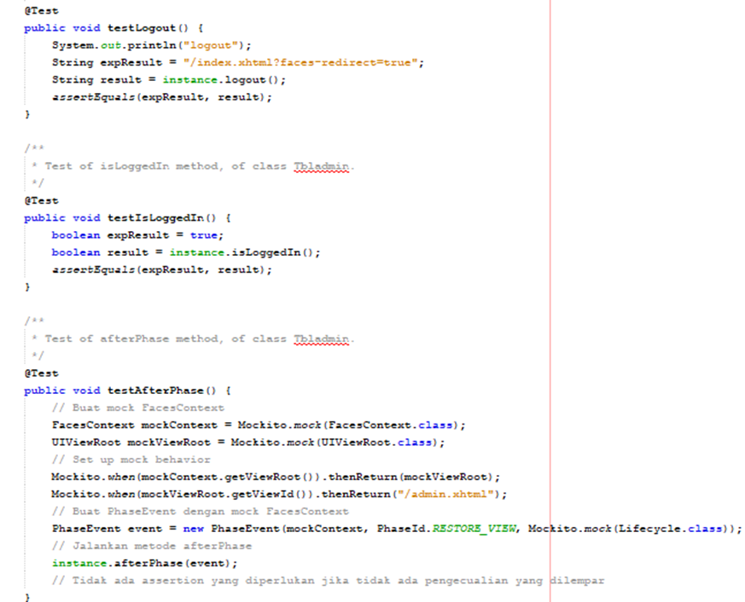
TESTING IMPLEMENTATION
TblAdminTest.java

Slide 23
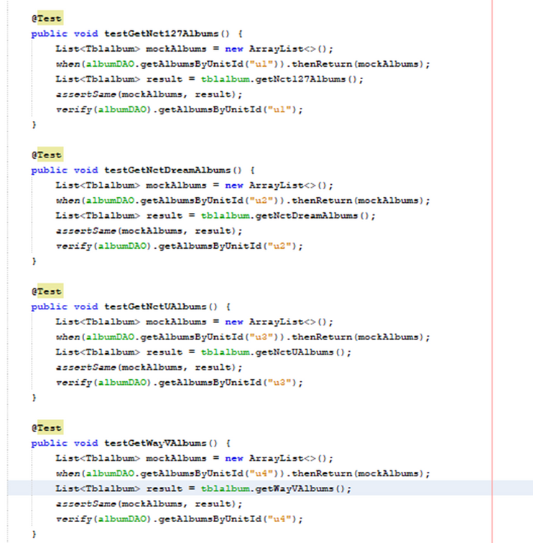
TESTING IMPLEMENTATION
TblAlbumTest.java

Slide 24
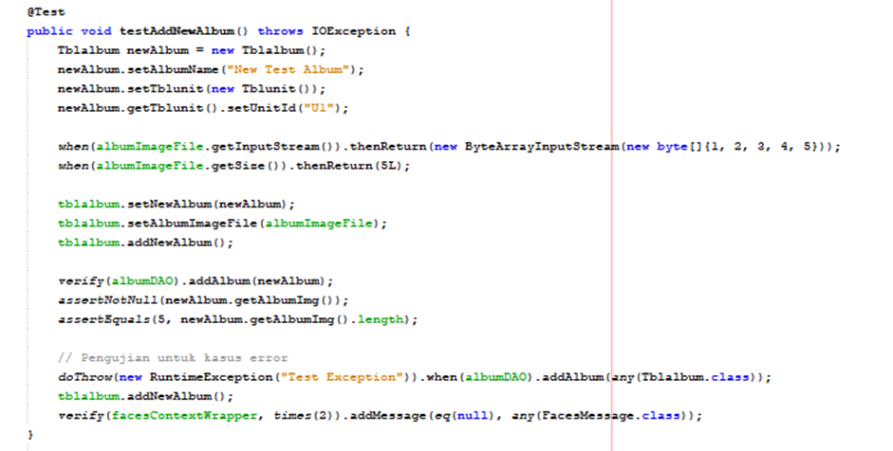
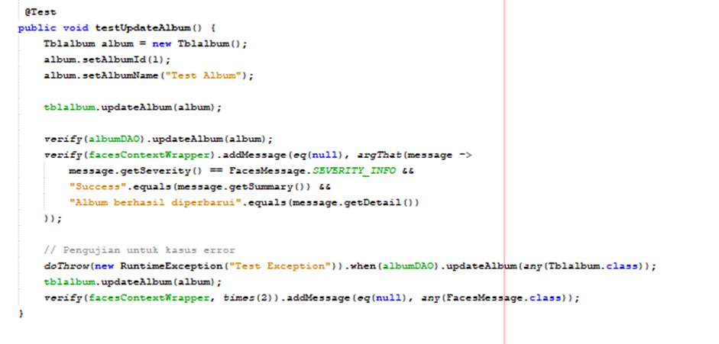
TESTING IMPLEMENTATION
TblAlbumTest.java

Slide 25
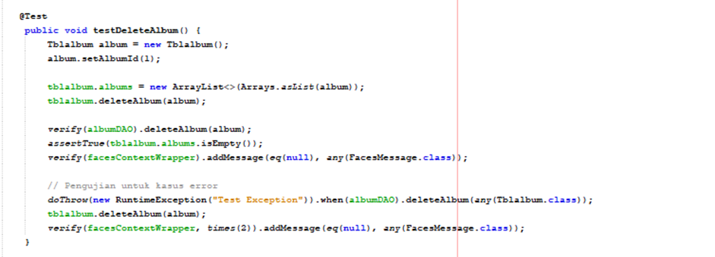
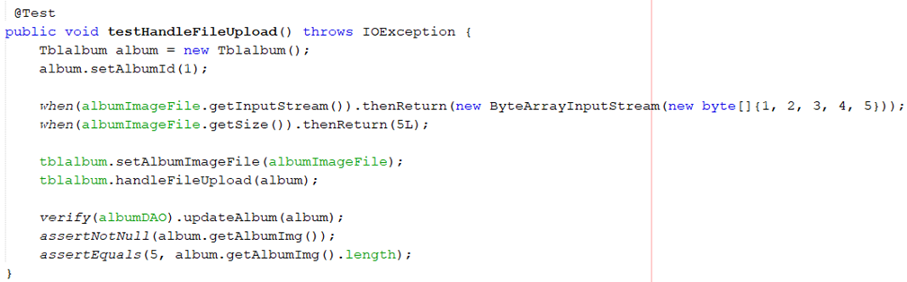
TESTING IMPLEMENTATION
TblAlbumTest.java

Slide 26
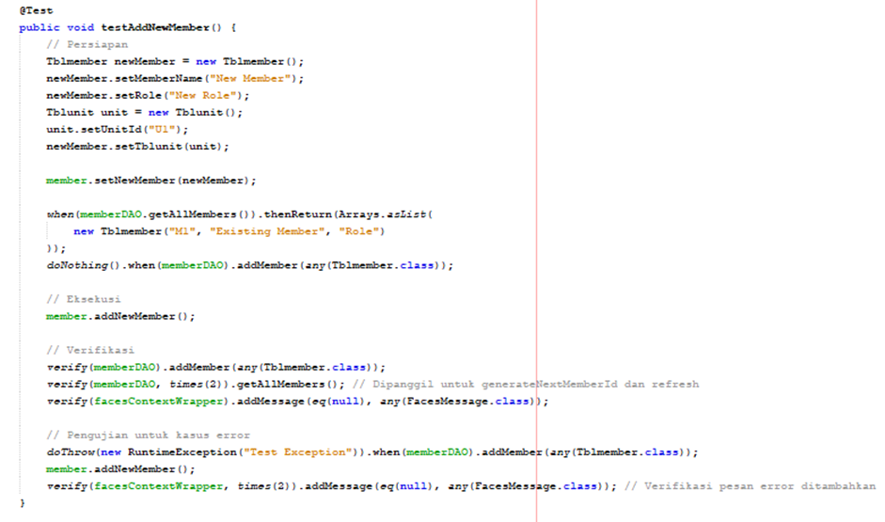
TESTING IMPLEMENTATION
TblMemberTest.java

Slide 27
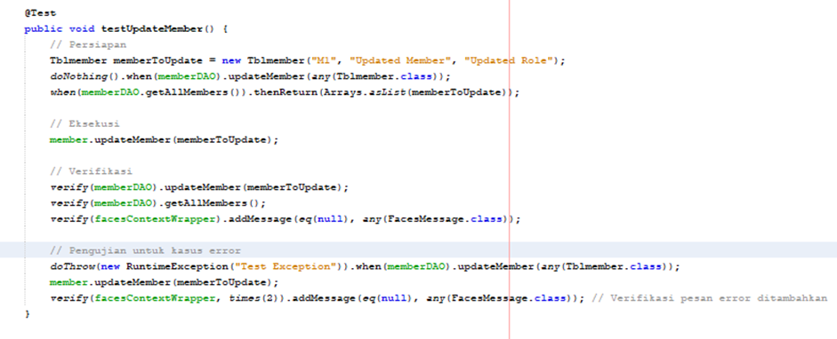
TESTING IMPLEMENTATION
TblMemberTest.java

Slide 28
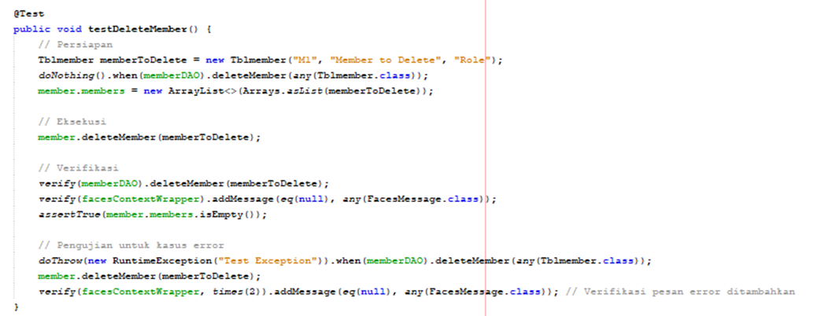
TESTING IMPLEMENTATION
TblMemberTest.java

Slide 29
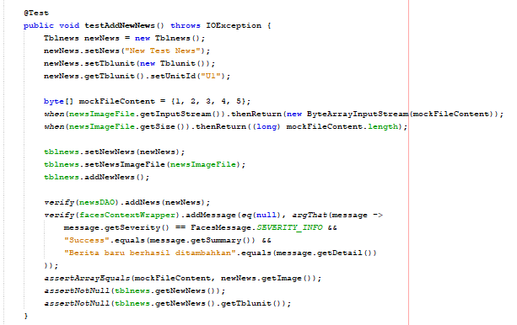
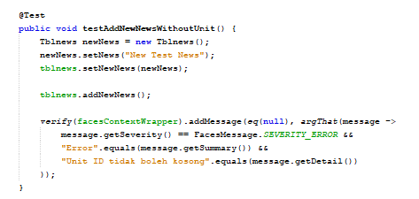
TESTING IMPLEMENTATION
TblNewsTest.java

Slide 30
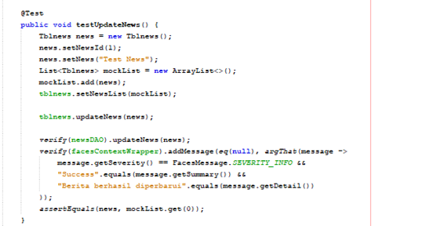
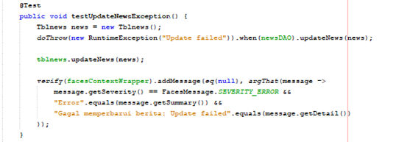
TESTING IMPLEMENTATION
TblNewsTest.java

Slide 31
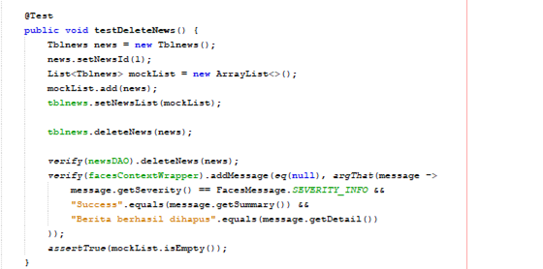
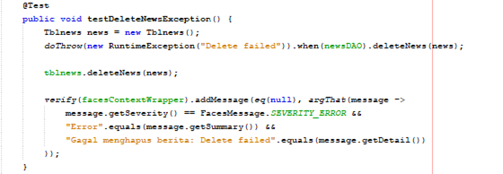
TESTING IMPLEMENTATION
TblNewsTest.java

Slide 32
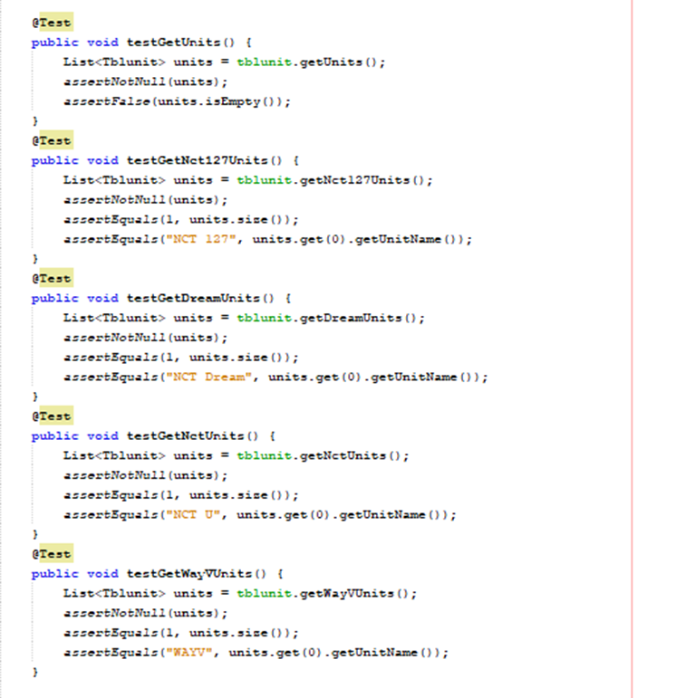
TESTING IMPLEMENTATION
TblUnitTest.java

Slide 33
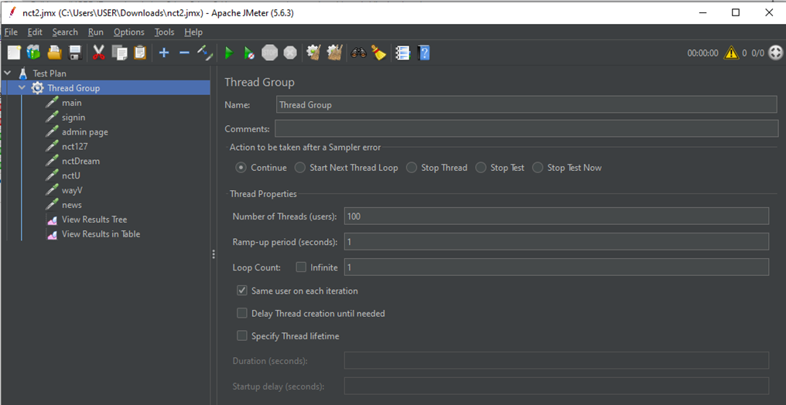
JMETER TESTING

Slide 34
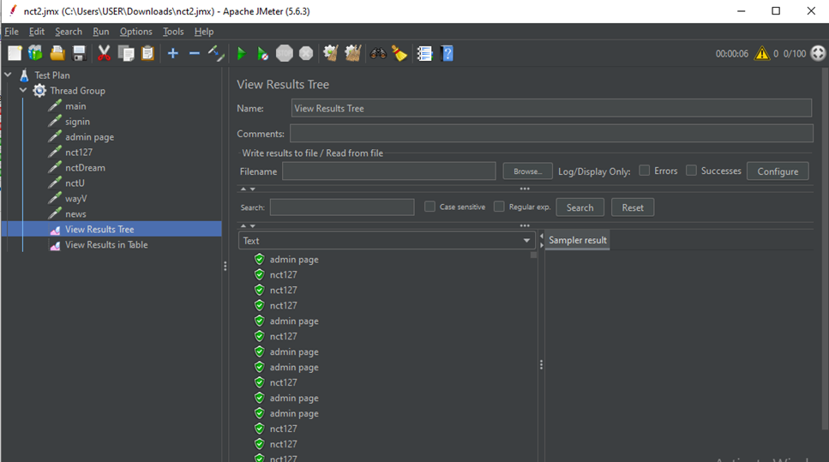
JMETER TESTING

Slide 35
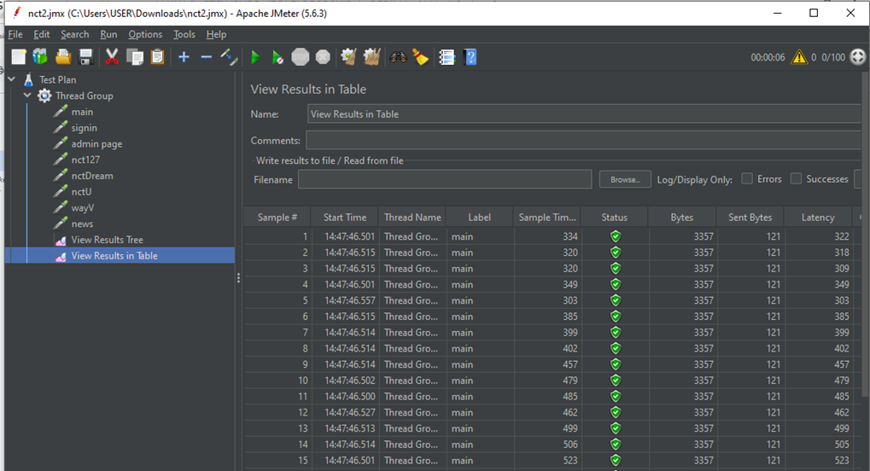
JMETER TESTING

Slide 36
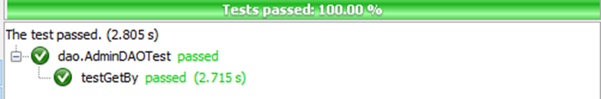
RESULT
AdminDAOTest.java

Slide 37
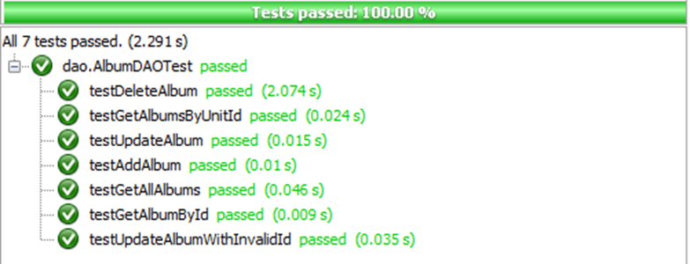
RESULT
AlbumDAOTest.java

Slide 38
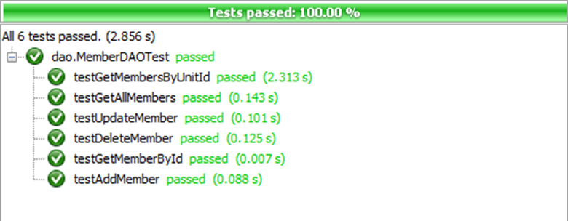
RESULT
MemberDAOTest.java

Slide 39
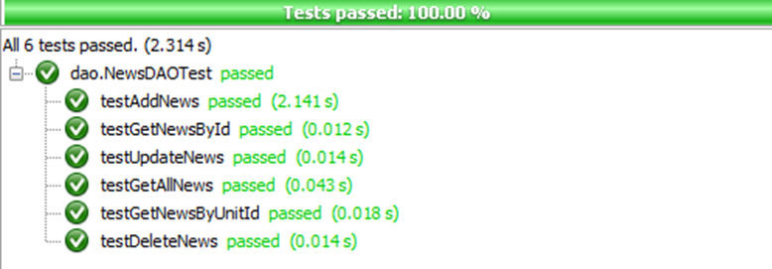
RESULT
NewsDAOTest.java

Slide 40
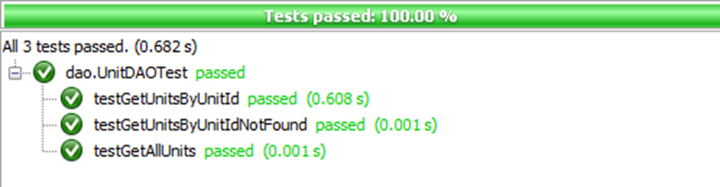
RESULT
UnitDAOTest.java

Slide 41
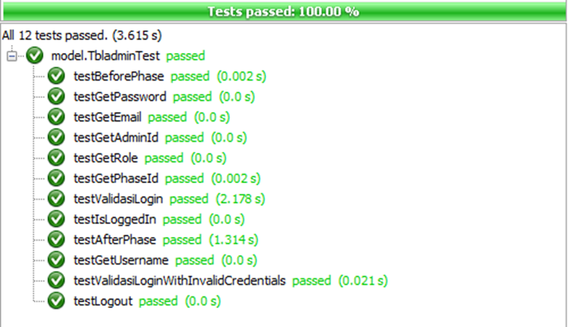
RESULT
TbladminTest.java

Slide 42
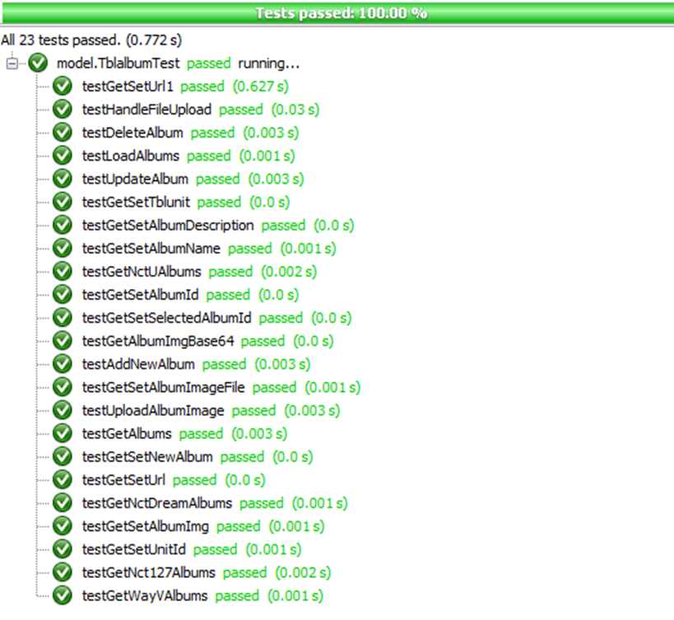
RESULT
TblalbumTest.java

Slide 43
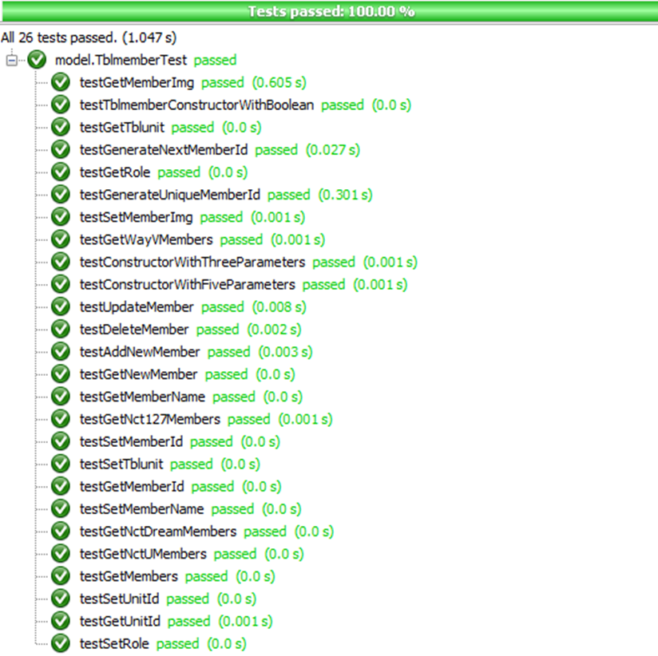
RESULT
TblmemberTest.java

Slide 44
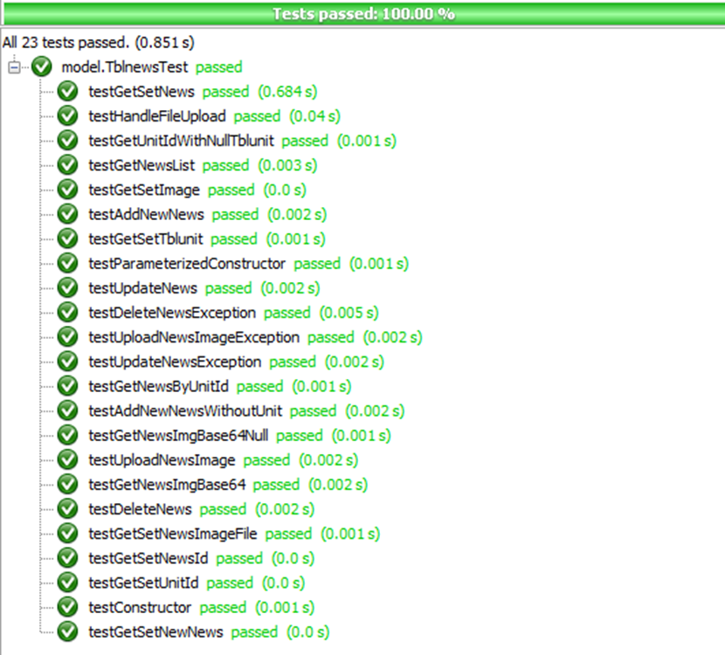
RESULT
TblnewsTest.java

Slide 45

RESULT
TblunitTest.java

Slide 46


JACOCO TESTING

Slide 47

JACOCO TESTING

Slide 48
THANK YOU
Group 6_3SE4

